Slide 1



Bug Tracking and Task Management System
Pandit Deendayal Energy University
School of Technology
Computer Science & Engineering
Student: Soshil Kumar Mukhiya
Supervisor: Dr. Davinder Paul Singh (Assistant Professor, SoT, PDEU)
Evaluator: Dr. Darshit Shah (Assistant Professor, SoT, PDEU)
Industry Name : LABMENTIX
Industry Address : Bengaluru, Karnataka, 590029
Industry Mentor : viral Jain
Mentor Contact No.: +91-9604083801
Email ID : support@labmentix.in

Slide 2



Introduction: The Need for Digital Systems
Problem Statement
Traditional manual bug tracking methods using spreadsheets, emails, and physical boards create significant challenges for software development teams. These fragmented approaches lead to lost information, unclear ownership, and difficulty tracking progress across multiple projects.
The absence of centralized digital systems results in reduced transparency, delayed issue resolution, and poor collaboration among team members working on complex software projects.

Slide 3
Project Objectives
01
02
03
Centralized Tracking
Improved Collaboration
Automated Workflows
Develop an integrated platform that consolidates all bug reports and task assignments in a single accessible location
Enable real-time communication and status updates among team members through unified workflows
Implement automated assignment rules, notifications, and status transitions to reduce manual overhead
04
05
Enhanced Transparency
Scalable Architecture
Provide comprehensive dashboards and reporting tools for tracking progress and identifying bottlenecks
Design a system that accommodates growing teams and increasing project complexity without performance degradation

Slide 4

Literature Review: Existing Solutions
1
2
Jira (Atlassian)
Bugzilla (Mozilla)
Industry-standard tool offering extensive customization and agile project management features. However, complex configuration requirements and steep learning curve can hinder adoption for smaller teams.
Open-source bug tracking system with robust reporting capabilities. Limited user interface modernization and requires significant server maintenance resources.
3
4
GitHub Issues
Trello (Atlassian)
Tightly integrated with code repositories, providing seamless version control linkage. Primarily designed for developers, lacking features needed for comprehensive project management.
Visual Kanban-style board for task organization. Intuitive interface but limited bug tracking capabilities and insufficient for complex software development workflows.
Common limitations across existing solutions include complexity, cost barriers, and lack of customization for specific institutional needs.

Slide 5




System Methodology & Architecture
Frontend
Backend
React.js for responsive user interface with component-based architecture ensuring maintainability
Node.js with Express framework handling API requests and business logic implementation
Database
MySQL for structured data storage ensuring data integrity and efficient query performance
The system implements a three-tier architecture separating presentation, application, and data layers. Bug reporting follows a standardized workflow from submission through triage, assignment, resolution, and verification stages.

Slide 6
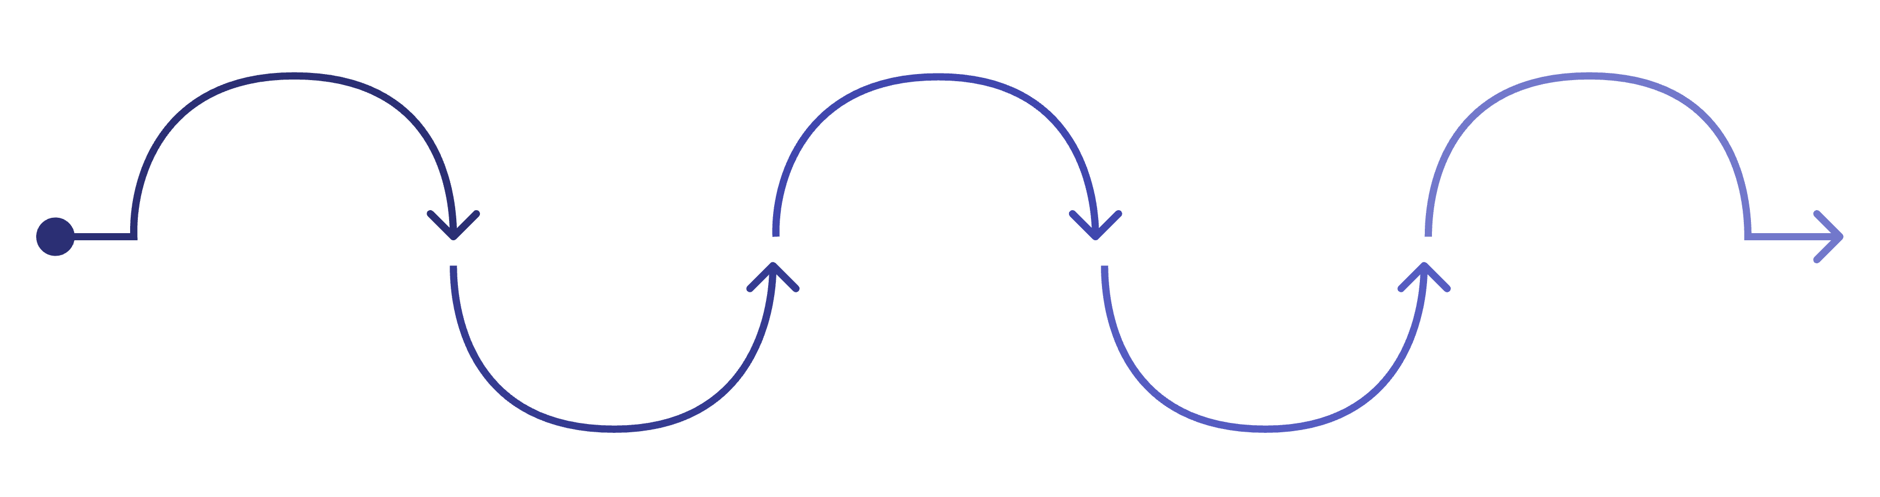
System Workflow Process
Triage Review
Implement Resolution
Report Creation
Assign Developer
Verify & Close
Assess severity, priority, and reproducibility
Develop fix and update audit trail
QA confirms fix and close ticket
Submit bug with details and logs
Route issue to responsible engineer
Each stage includes automated notifications to relevant stakeholders, status tracking, and audit trail documentation. The workflow ensures accountability at every step while maintaining flexibility for edge cases and priority escalations.

Slide 7

Progress & Work Completed (IA1)
Requirements Analysis
Completed stakeholder interviews and gathered functional requirements from development teams
System Design
Finalized ER diagrams, API specifications, and user interface wireframes
Technology Stack
Selected and configured all development tools, frameworks, and database systems
UI Prototyping
Developed interactive mockups for dashboard, bug reporting form, and task management views

Slide 8

Roadmap for IA2 Completion
Feature Development
Deployment
Complete core functionality including user authentication, bug tracking module, and task assignment system
Deploy to production environment with data migration from existing systems if applicable
1
2
3
4
Testing Phase
Documentation
Conduct unit testing, integration testing, and user acceptance testing with real development teams
Prepare comprehensive technical documentation, user manuals, and final project presentation
Timeline: 8-10 weeks from IA1 to IA2 completion, with bi-weekly milestone reviews and progress tracking

Slide 9
Expected Outcomes & Benefits
40%
25%
95%
Time Reduction
Productivity Gain
Traceability
Expected decrease in bug resolution time through streamlined workflows
Anticipated increase in team productivity from automated processes
Complete audit trail coverage for all reported issues and resolutions
Key Benefits
Real-time visibility into project status for all stakeholders
Reduced communication overhead through centralized platform
Improved accountability with clear ownership of tasks
Historical data for performance analysis and process improvement

Slide 10

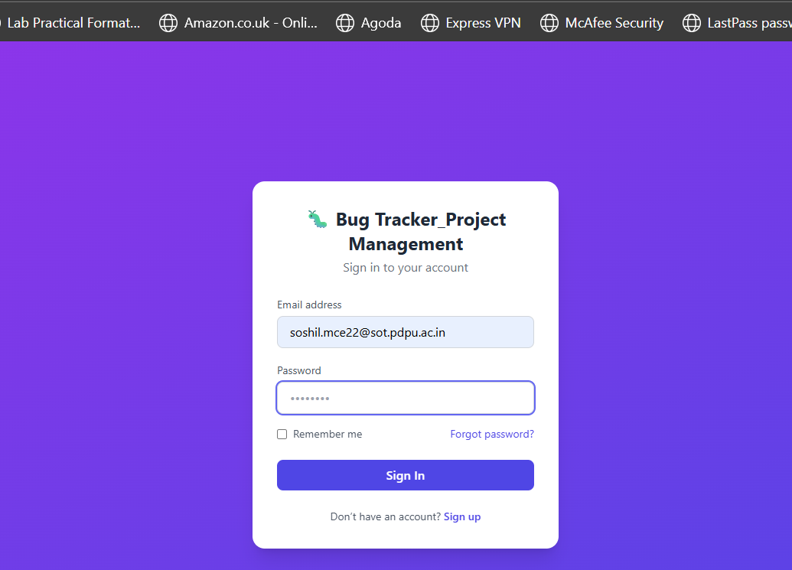
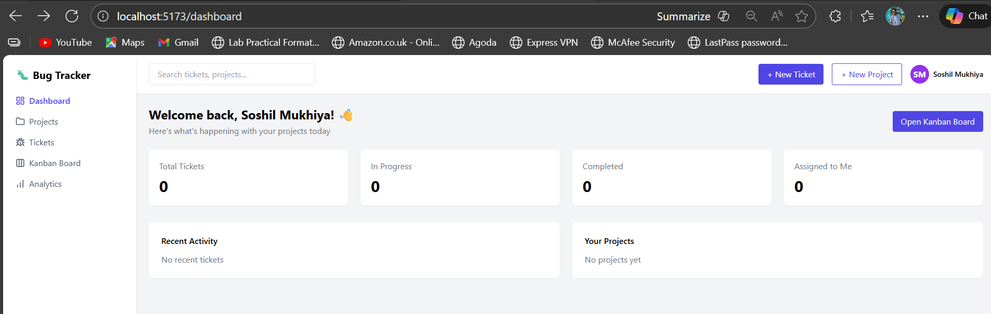
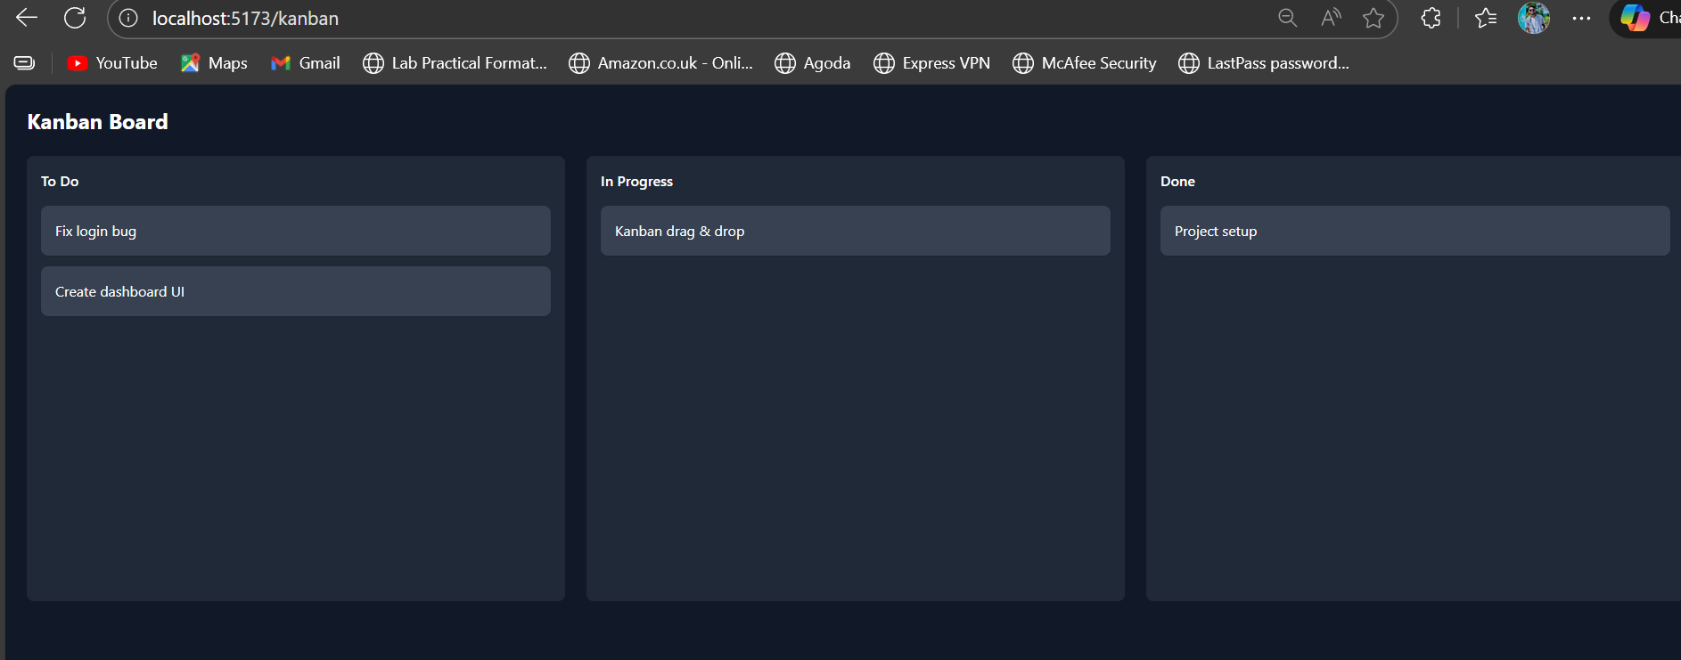


Slide 11
References
Academic Papers
Technical Documentation
Research Articles
[1] F. Zamfirov, “A literature review on different types of empirically evaluated bug localization approaches,” arXiv preprint arXiv:2212.11774, 2022. [Online]. Available: https://arxiv.org/abs/2212.11774
[2] S. Bhattacharya, S. Sujatha, and D.S. Jat, “Comparative analysis of bug tracking tools," ResearchGate, 2016. Available: https://www.researchgate.net/publication/316888056_Comparative_analysis_of_bug_tracking_tools
[3] Atlassian, "Jira Software Documentation," 2024. [Online]. Available: atlassian.com/jira
[5] T. Hai, “Cloud-based bug tracking software defect analysis using deep learning,” J. Cloud Comput., 2022. Available: https://link.springer.com/article/10.1186/s13677-022-00311-8
[4] Mozilla, "Bugzilla Guide," 2024. [Online]. Available: bugzilla.org/docs
[6] G. Long and J. Gong, “Learning software bug reports: A systematic literature review,” arXiv:2507.04422, 2025. Available: https://arxiv.org/abs/2507.04422

